Slide 1


The DBA’s Guide to Power BI
May 12, 2023

Slide 2


Jarid McKenzie
Partner & Lead Architect
10+ Years of BI Experience
Teacher, Mentor & Community Leader

Slide 3




Who I actually am!
My Website
LinkedIn
GitHub (Foundatum)
Hopefully a YouTube channel coming out!

Slide 4



What are we going to talk about
Talk about 3 things to kickstart one journey into Power BI:
Constraints and underlying design choices for Power BI
Data Architecture
Visual Techniques
Notes:
(career boost)

Slide 5

Constraints

Slide 6

What is the Power BI Engine for? (At least the engine)
The Vertipaq engine is specialized in 3 things:
Filtering large datasets
Aggregating those datasets
Capturing and manipulating the context in which a calculation is performed

Slide 7

The Vertipaq Engine
Power BI, Excel's Power Pivot and SSAS Tabular all share the same engine. It's an in-memory columnar database.

Slide 8
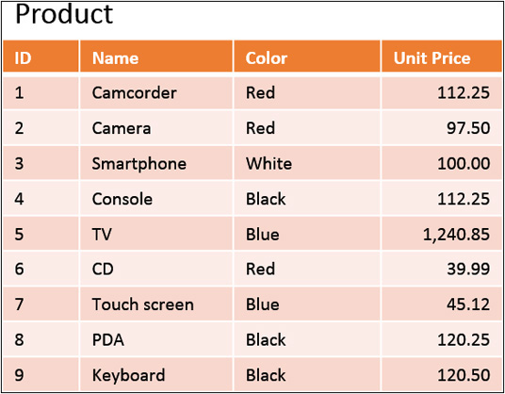
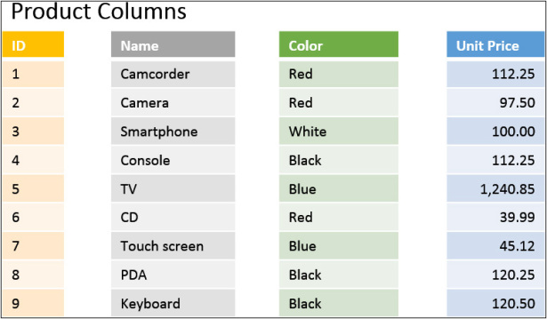
What is a columnstore database?
https://www.microsoftpressstore.com/articles/article.aspx?p=2449192&seqNum=2

Slide 9

How Does Vertipaq compress data?

Slide 10
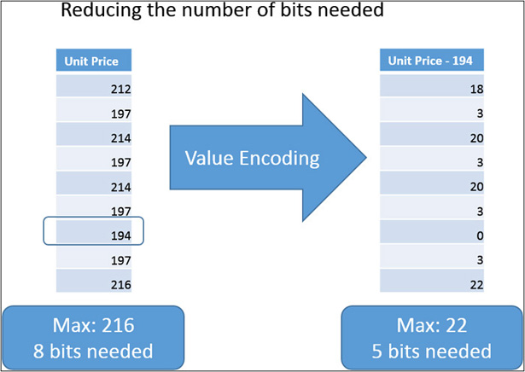
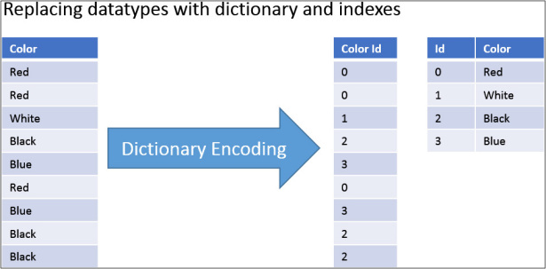
Encoding Data
https://www.microsoftpressstore.com/articles/article.aspx?p=2449192&seqNum=3

Slide 11
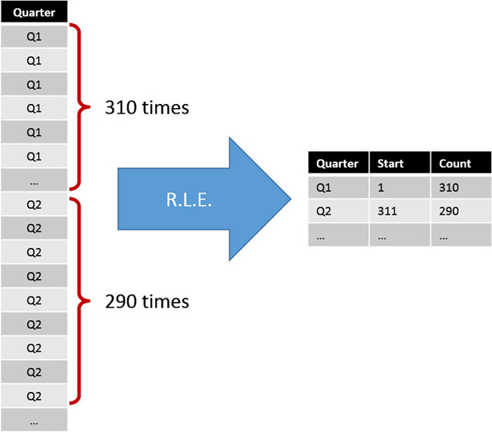
Run Length Encoding (RLE)

Slide 12
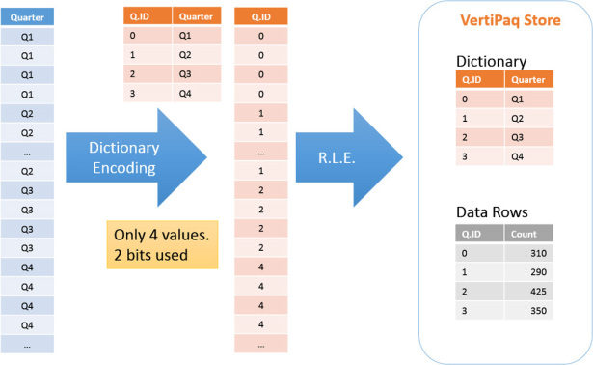

Putting it together

Slide 13

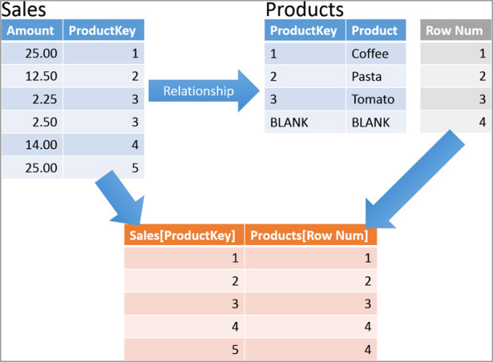
How about Relationships between tables?
An intermediary table is created when a relationship is formed between tables. This is essentially an index on foreign keys.
Chris Sorensen
Jarid McKenzie

Slide 14

Implications
The lower the cardinality of a column, the more efficient queries with that column are
Data duplication only marginally effects performance
Relationships are based on single columns on two tables
Traversing relationships is an expensive operation, but also necessary

Slide 15


Data Architecture

Slide 16
Different Types of Data Models
One Big Table (traditional non-technical implementation)
Normal Models (3NF, Boyce-Codd, 4NF, 5NF…)
Inmon corporate information factory (Normalized Datamarts)
Data Vault
Kimball Dimensional Model or Star Schema

Slide 17
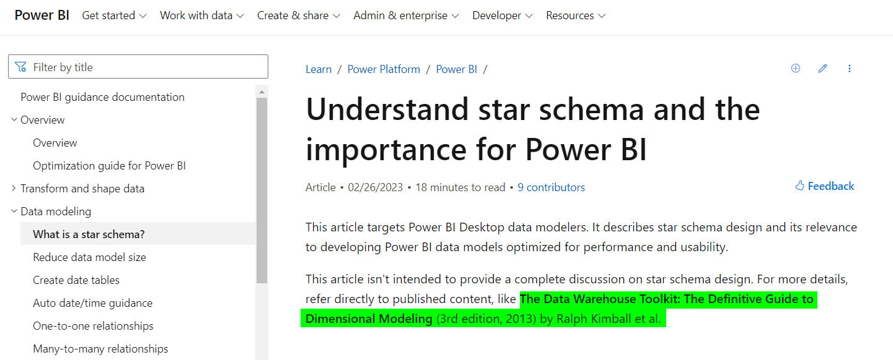
Also, Microsoft Agrees
https://learn.microsoft.com/en-us/power-bi/guidance/star-schema

Slide 18
Two(ish) types of data
Star Schemas divide the data into two categories:
Data that measures an event (Facts)
Data that describes an event (Dimensions)
There are also bridge tables for traversing more complex relationships

Slide 19
Basic Example
Fact Table (events)
Dim (descriptor)
Dim (descriptor)
Dim (descriptor)
Dim (descriptor)

Slide 20
Four-Step Dimensional Design Process
Select the Business Process.
1
Declare the Grain.
2
Identify the Dimensions.
3
Identify the Facts and Measurements
4
https://www.kimballgroup.com/data-warehouse-business-intelligence-resources/kimball-techniques/dimensional-modeling-techniques/four-4-step-design-process/

Slide 21



Let’s try with an example from Supply Chain
Request
Request
Products
Products
Money
Money

Slide 22
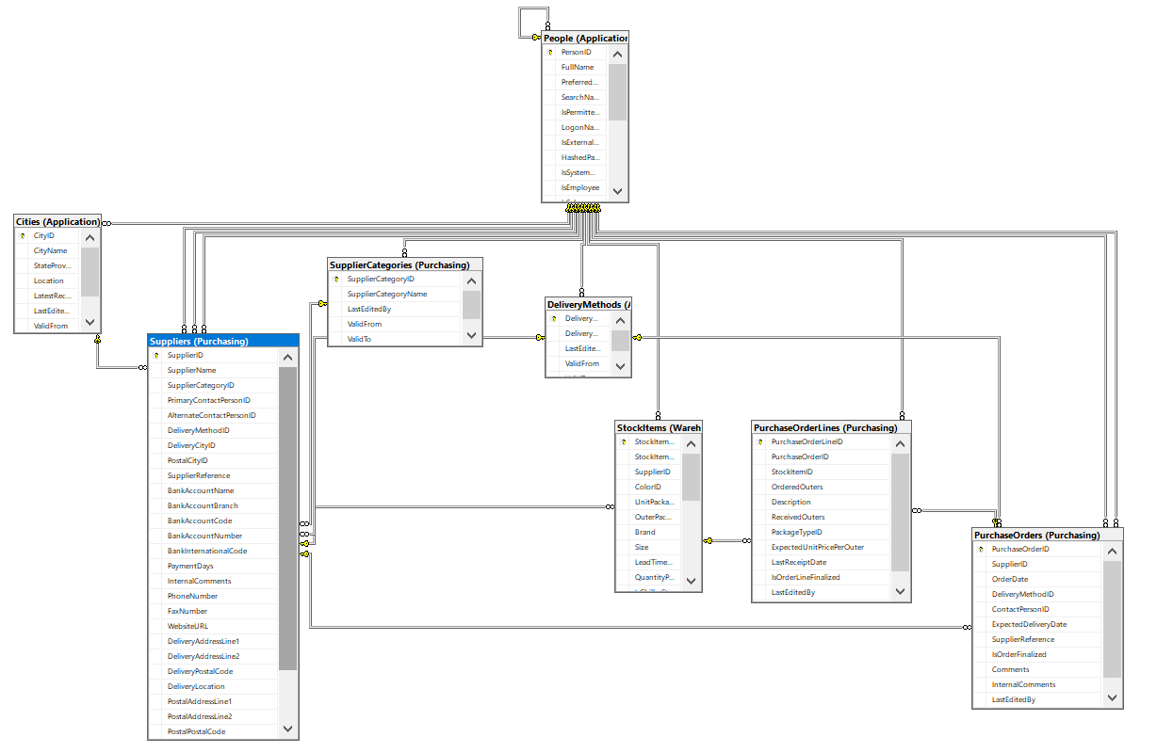
What does the DB look like?

Slide 23
Four-Step Dimensional Design Process
Select the business process.
Purchase Orders
1
Declare the grain.
One row per Purchase Order Line
2
Identify the dimensions.
Dates (Order Date and Expected Delivery Date)
Stock Items (Products)
Suppliers (Vendors)
3
Identify the facts.
Products Ordered and Received
Expected Cost
4

Slide 24
Purchases Model:
Purchase Order
Order Date
Expected Delivery Date
Stock Items
Suppliers
Measures:
Count Orders
Expected Cost
Products Received

Slide 25

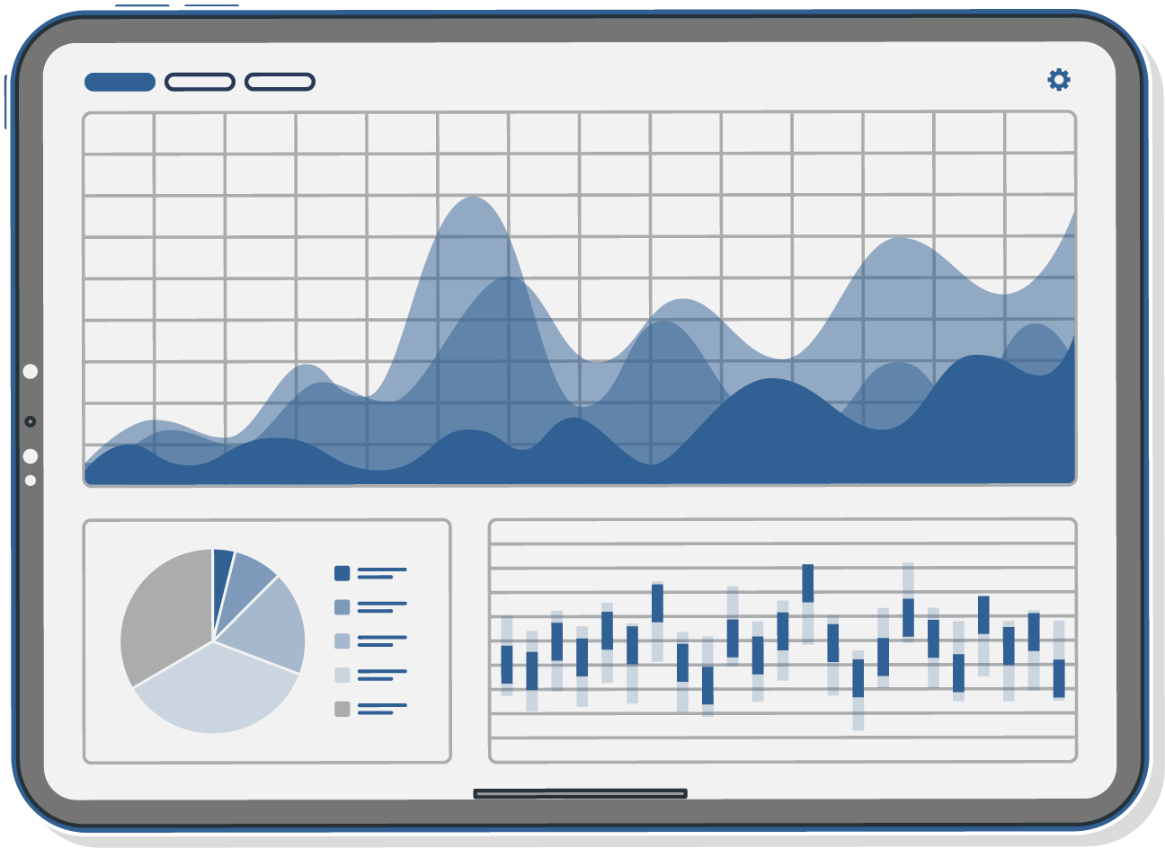
Visual Techniques

Slide 26






The MAD Framework
Monitor
KPIs
Executives
Analyze
Summarized Data
Middle Management
Details
Detailed and Raw Data
Analysts

Slide 27
The MAD Framework
Monitor
KPIs
What’s Current
Analyze
Summarized Data
What’s Happened
Details
Detailed and Raw Data
Prove It

Slide 28

Colour Theory Basics

Slide 29
Don’t
Reinvent the wheel

Slide 30
Primary Colour Palette
The primary corporate colour palette:
RGB:
52/96/148
HEX: #316094
PMS: PAN 653 C
RGB:
84/87/89
HEX: #53575A
PMS: PAN 425 C
RGB:
124/133/140
HEX: #7B868C
PMS: PAN 430 C

Slide 31

Secondary Colour Palette
The secondary corporate colour palette:
HEX: #283959
HEX: #D98B2B
HEX: #BFBFBF
HEX: #A6A6A6
HEX: #404040
The blues are orange are for accent and pops of colour.
The greys are used to replace a black font and can be used to support other design details and elements.

Slide 32
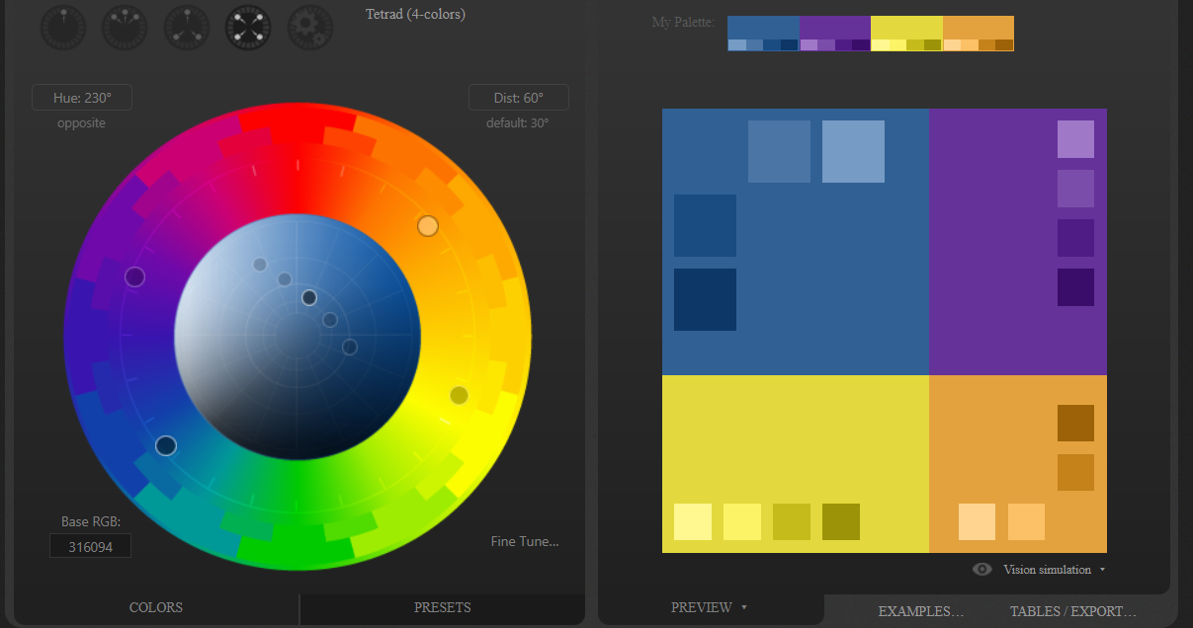
Notes:
http://paletton.com/

Slide 33
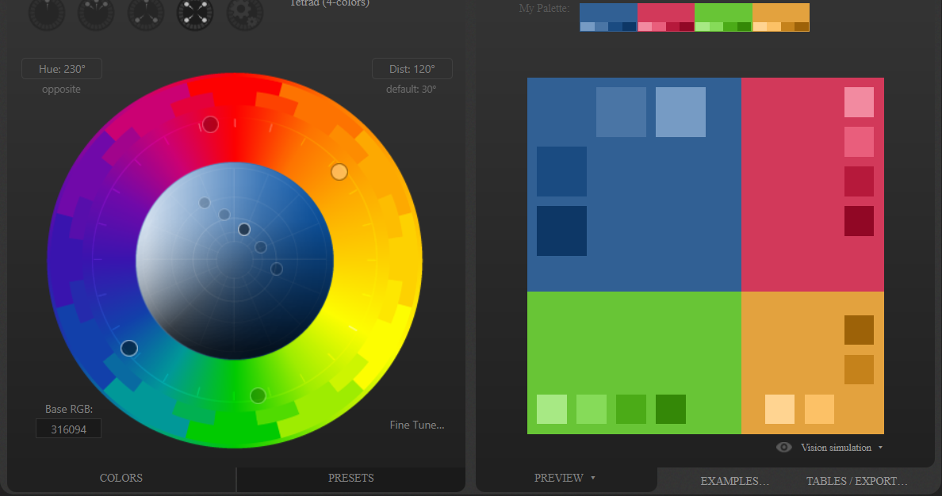
Notes:
http://paletton.com/
https://www.learnui.design/tools/data-color-picker.html

Slide 34
Which Visual Should I Use?

Slide 35
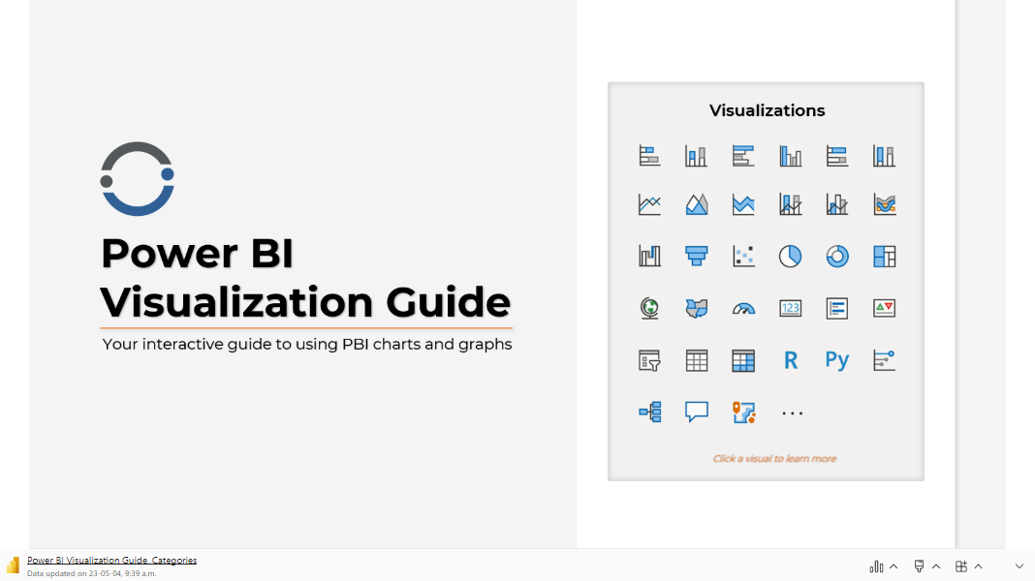
Notes:
https://iterationinsights.com/article/power-bi-visualization-guide/

